Slide 1
OpenGL - Error handling
Advanced Graphics Programming

Slide 2
OpenGL - Error handling
OpenGL programming can be very error prone
Most of the time, a single failing call to OpenGL can cause an entire portion of an application to stop working, with nothing being drawn on the screen.
Examples:
Not sending a transformation matrix properly.
Not attaching an output texture to a render target properly.
A certain call failed and the following were assuming everything was ok.

Slide 3
Standard OpenGL way...

Slide 4
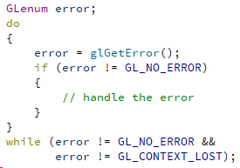
OpenGL - Error handling
Make sure no errors are being returned by OpenGL:
After every API call
At some points in your application
Errors stack up, so they have to be handled with the function glGetError() using a loop.

Slide 5
OpenGL - Error handling
For a list of all errors returned by glGetError() you can refer to the following page:
https://www.khronos.org/opengl/wiki/OpenGL_Error

Slide 6
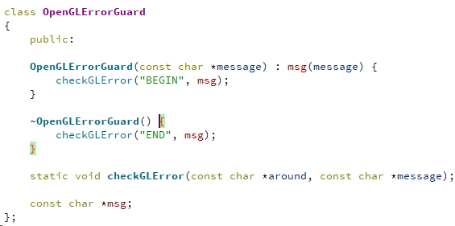
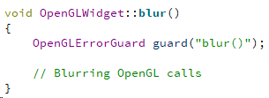
OpenGL - Error handling
Error guards
Objects to check errors within a scope
Use of constructor and destructor
Usage
Define an object at some point within a scope
The object will check for errors when created and destroyed
glGetError() stuff...

Slide 7
Qt OpenGL way...

Slide 8
OpenGL - Error handling
QOpenGLDebugLogger aims at addressing these issues.
Provides access to the OpenGL debug log.
Internal driver stuff.
Your OpenGL implementation needs to support it.
By exposing the GL_KHR_debug extension.
Messages from the OpenGL server will be either logged in an internal OpenGL log, or passed in "real-time" to listeners as they're generated from OpenGL.

Slide 9
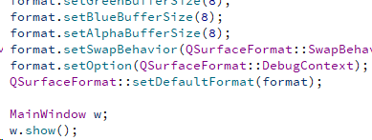
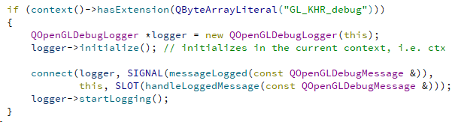

OpenGL - Error handling
In main.cpp...
In OpenGLWidget::initializeGL()
Slot to capture logged messages...
At the beginning of our application, we ask for a debugging context that logs messages.

Slide 10
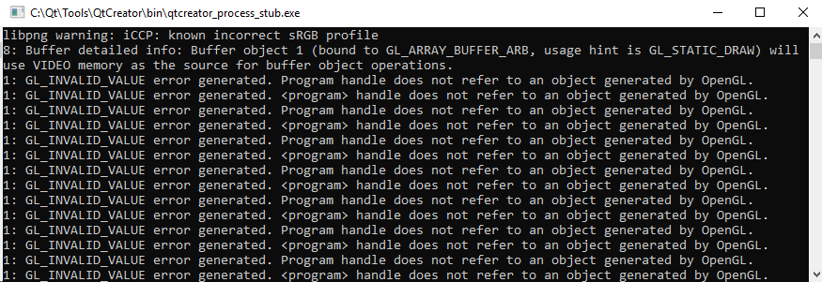
OpenGL - Error handling
If in paintGL() I use a program that does not exist...

Slide 11
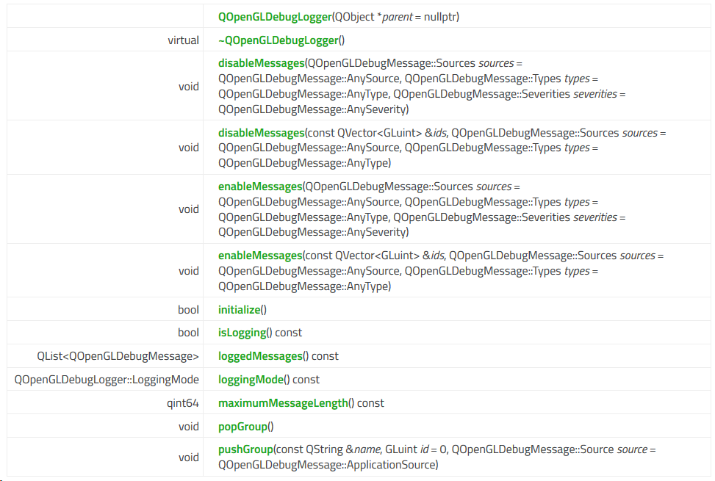
OpenGL - Error handling
Other functions in the QOpenGL DebugLogger class:
Level of verbosity
disableMessages()
enableMessages()
Retrieve all logged messages
loggedMessages()

